Slide 1
COA Annual Report to the Commission 2021-2022
December 8, 2022
Robert Frelly, COA Co-Chair, Chapman University
Martin Martinez, COA Co-Chair, Sacramento County office of Education
Cheryl Hickey, Administrator, Professional services Division
Erin Sullivan, Administrator, Professional Services Division

Slide 2
Size and Scope of System 2021-22
2

Slide 3
Number of Programs
942 Programs (910 active, 32 inactive)
Type of Program | Active | Inactive | Total
Prelim Teaching/Intern | 325 | 6 | 331
Induction – Teaching and Admin | 229 | 6 | 235
Services Credentials | 182 | 8 | 190
Added Authorizations and Specialists | 144 | 12 | 156
Designated Subjects | 30 | 0 | 30
Total | 910 | 32 | 942
3

Slide 4
Accreditation Cycle
Annually: Annual Data Submission, Data Analysis, Survey Data
Years 1/4: Preconditions due
Year 5: Program Review & Common Standards Review
Year 6: Accreditation Site Visit
Year 7: Follow-Up
4

Slide 5
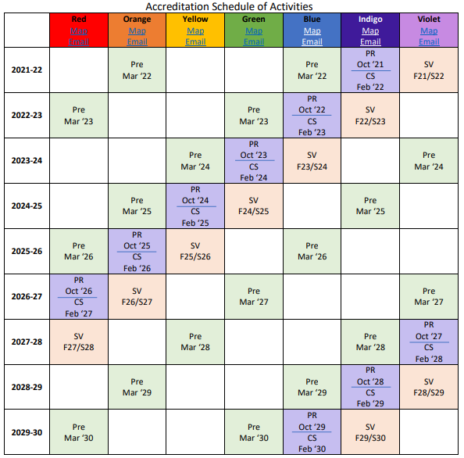
Accreditation Schedule of Activities

Slide 6
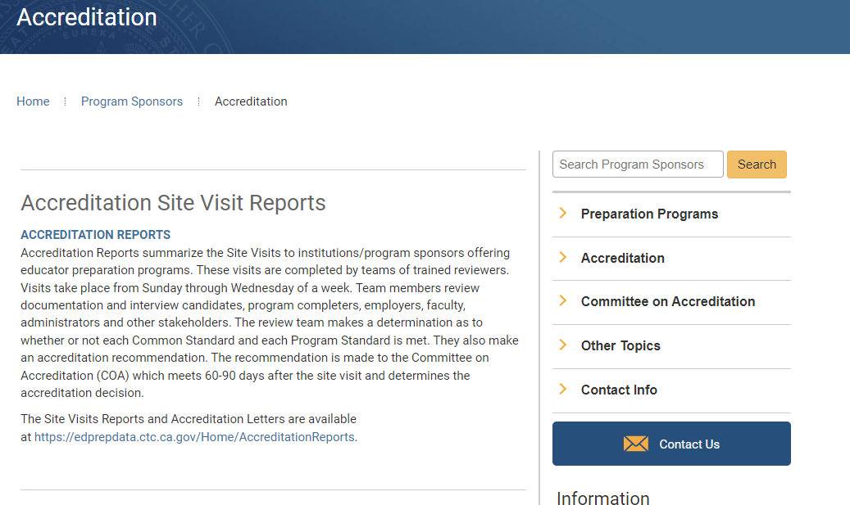
Transparency in Accreditation
All Accreditation Site Visit Reports are Available Online
6

Slide 7
COA Oversight and Enforcement of Commission’s Accreditation System
COVID flexibilities
Updated Framework = Updated Procedures Manual
Transition of programs to new standards
New and improved data dashboards
Crosswalks with national standards
Recommendations for ongoing improvement
7

Slide 8
Purpose of Accreditation & Role of COA
Framework includes 5 statements of purpose
Provides structure within which COA operates
8

Slide 9
Ensuring Accountability to the Public and the Profession
6 meetings
Held publicly
Agendas, decisions, final reports
9

Slide 10
Ensuring Program Quality
40 site visits with reporting
33 regular visit
4 provisional site visits
3 revisits
Monitoring institutions that receive stipulations
10

Slide 11
Ensuring Program Quality
Technical assistance
Staff debrief of presentations at major conferences
Year-out previsit, monthly check-ins, 2 month-out previsit
Office hours (weekly/bi-weekly subject-specific check-ins)
Trainings for Board of Institutional Review members
Subject-specific email addresses
11

Slide 12
Ensuring Adherence to Standards
Approve new programs – IPR and IIA
Preconditions – 68 institutions in Orange and Blue cohorts with 816 general and 1146 program-specific preconditions
Program Review – 34 institutions in Indigo cohort with 125 programs
Common Standards Review – 34 Indigo institutions
Accreditation Data System, including new surveys and dashboards
12

Slide 13
Ensuring Evidence is Reviewed by Peers
Trained BIR members for Program Review, Common Standards Review, site visits, IIA, and IPR
BIR training
13

Slide 14
Fostering Program Improvement
Monitoring for programs out of compliance
Analysis of feedback from site visit institutions and teams
Partnerships with national accrediting bodies
14

Slide 15
Procedural Modifications
COA receives in Stage IV all prior documentation submitted by new institutions in Stages II-III of IIA
COA reviewed, approved, and recommended to the Commission refinements to Stage V of IIA
15

Slide 16
Accreditation Decisions 2021-22
6th Year Accreditation Site Visits at 33 program sponsors
16

Slide 17
Of Note
Of the 22 with Accreditation – 7th year reports required for 6 of them
15 institutions met all Common and Program Standards (page 26)
Common Standard 1 (institutional Infrastructure) and 4 Continuous Improvement were the two C.S. with the most frequent findings (page27)
17

Slide 18
Of Note
Program Standards with the Most Frequent Findings (page 29-30):
Difficult to find trends between programs due to varying number of programs offered across the state
Generally, data does not suggest major across the board challenges for a particular standard/area
Induction – both Teacher and Admin – standard related to selection and training of mentors most frequent but data also reflect a larger number of programs than other programs reviewed
18

Slide 19
Provisional Site Visits
4 Additional Site Visits Took Place at Institutions in Provisional Status
COA Considered Accreditation for a total of 7 Provisional Institutions (some in prior year’s)
All have been granted full approval (see page 34)
19

Slide 20
COA Is Ensuring Issues are Addressed
Institutions with Stipulations in 2020-2021 Requiring Follow Up: 9 institutions (7 stips, 1 major, 1 probationary)
Commission staff works closely with all institutions with Stipulations
Frequent use of Quarterly Reports/6th month reports
COA was able to remove stipulations for all of them in 2021-22
20

Slide 21
COA Follow Up of Institutions with Stipulations
Institution | Action by COA | Required Follow Up
Aspire Berkely Maynard | Stipulations (upgraded from major stipulations in 2021) | Follow Up Report
CSU DH | With Stipulations | Follow Up Report
Anaheim Union HS District | With Stipulations | 6th month progress report Follow Up Report with Action Required
High Tech High GSE | With Stipulations | Follow Up Report with Action Required
UC Merced | With Stipulations | Follow Up Report with Action Required
Bay Area School of Enterprise | With Major Stipulations | 6th month report Revisit Prohibited from new programs
Pacific Union College | With Stipulations | Follow Up Report with Action Required
Point Loma Nazarene University | With Stipulations | Follow Up Report Revisit
Pleasanton Unified SD | With Probationary Stipulations | Quarterly Reports Revisit Prohibited from new programs
21

Slide 22
New Programs Approved
Type | Number of Programs
New Programs at Institutions with Provisional Approval | 8
Existing Commission Approved Institutions | 21
Subject Matter (Commission approval) | 5
22

Slide 23
New Programs Approved 2021-22
Credential Type | Approved Institutions | Provisional Institutions | Total New Programs
Bilingual Authorization | 7 | 0 | 7
MS and MS Intern | 5 | 2 | 7
Teacher Induction | 0 | 5 | 5
Administrator Induction | 3 | 0 | 3
DS: Career Tech Ed | 2 | 0 | 2
Speech Language Pathology | 2 | 0 | 2
Single Subject Intern | 1 | 1 | 2
Education Specialist MMSN | 1 | 0 | 1
Total New Programs | 21 | 8 | 29
23

Slide 24
Other Actions Taken by COA
Type of Action | Number of Programs
Programs Made Inactive (p. 35) | 14
Programs Withdrawn (p. 37-38) | 18
Programs Reactivated (p. 36) | 1
Institutions Closing as Program Sponsor (p. 36) | 1
Monitor the Transitions to the New Education Specialist Program Standards (p. 36-37) | 140 programs at 72 institutions
24

Slide 25
Part III – 2022-23 Priorities
Precondition Review – 54 institutions (Red and Green)
Program Review/C.S. Review – 33 institution (Blue Cohort)
Conduct 31 Site Visits (Indigo Cohort)
Conduct 3 Revisits
Conduct 2 Provisional Site Visits for Initial Institutional Approval
Follow Up (7th Year Reports/Quarterly Reports/Stipulations) for 17 institutions
Trainings – BIR/Team Lead/Accreditation 101 and 201
Technical Assistance/Support for Institutions for Accreditation Activities
25

Slide 26
Non-Routine Priorities – 2022-23
Revise and Update the Accreditation Handbook – DONE
New partnership agreement with CAEP – DONE
Rethinking Site Visit Structure Going Forward
Assist and monitor first year implementation of PPS and Education Specialist Standards
Continued assistance related to lingering pandemic issues (candidate completion)
Refinements to ADS/Completer Surveys etc.
26

Slide 27
New Priorities
PK-3 Credential Program Approval
Developing Initial Program Review Process, including evidence required
Recruitment and training of reviewers
Hold review sessions and, once OAL approves regulations, approve new programs
27

Slide 28
New Priorities
SB 488 Implementation
Technical Assistance and Information Dissemination
Determination of Evidence to be Submitted for Initial Program Review and Program Review
Guidance for Teams, Recruitment of Reviewers with Expertise, Training on Reviewing the Standard
Preconditions Review
Development of Certification Process
28

Slide 29
New Priorities
Develop Systemic Processes for Analysis and Use of Statewide Data
Currently excellent job of using in accreditation
Need to work to improve systems to identify issues on a statewide/institutional basis
29

